Slide 1
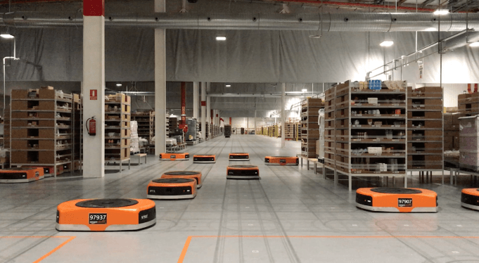
Amazon Robotics machines in a Amazon warehouse
Collision avoidance and coordination for a fleet of robots
Luca Marseglia

Slide 2
Summary
Prioritized planning | Genetic Algorithm
 | Single-objective |  | Multi-objective
 | Maximum velocities | Slow-down segment | Slow-down segment
2024 August | Slide 2

Slide 3
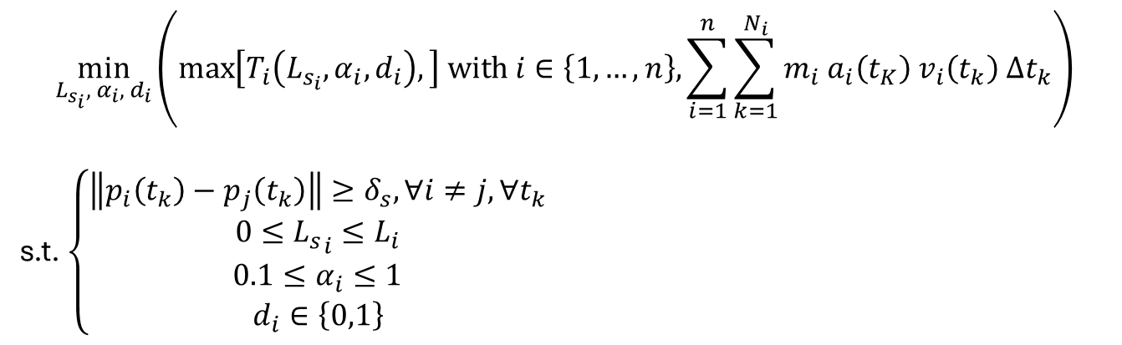
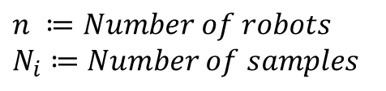
Multi-objective problem setting
$$\min_{L_{s_{i}}, α_{i}, d_{i}}\left(\max\left[T_{i}\left(L_{s_{i}},α_{i},d_{i}\right),\right] with i∈\left\{1,…,n\right\}, \sum_{i=1}^{n}{\sum_{k=1}^{N_{i}}{m_{i} a_{i}\left(t_{K}\right) v_{i}\left(t_{k}\right) Δt_{k}}}\right)$$
s.t. $\left\{\begin{aligned}\left\|p_{i}\left(t_{k}\right)−p_{j}\left(t_{k}\right)\right\|≥δ_{s}, ∀i≠j,∀t_{k} \\ 0≤{L_{s}}_{i}≤L_{i} \\ 0.1≤α_{i}≤1 \\ d_{i}∈\left\{0,1\right\}\end{aligned}\right.$
$$n ≔Number of robots$$
$$N_{i}≔Number of samples$$
2024 August | Slide 3

Slide 4
New Specifications
Warehouse size: 100 x 75 m
AGVs’ diameter: 1 m
Max velocity: 1.5 m/s
Max acceleration: 1 m/s^2
2024 August | Slide 4

Slide 5
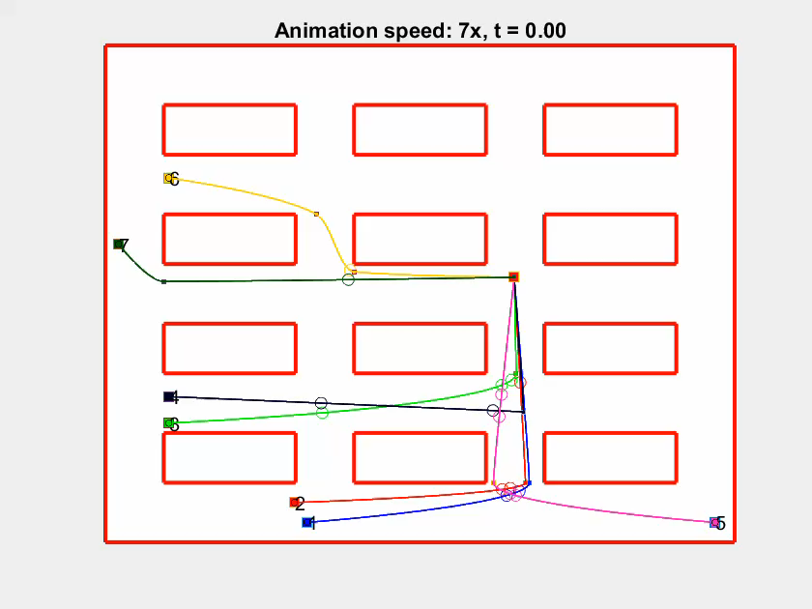
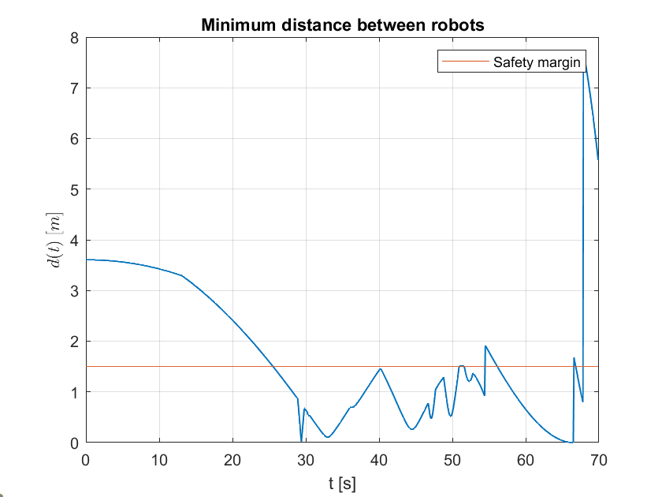
Starting scenario
Max velocities | 1.5 m/s
Finish time | 76.70 s
Total energy | 3012 J
2024 August | Slide 5

Slide 6
Prioritized planning | Genetic Algorithm
 | Single-objective |  | Multi-objective
 | Maximum velocities | Slow-down segment | Slow-down segment
Population | 1000
Crossover Factor | 60%
Mutation Rate | 70%
Generations | 200
2024 August | Slide 6

Slide 7
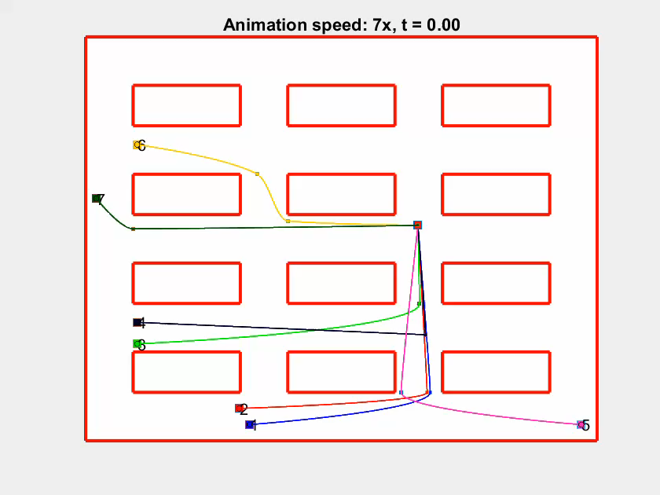
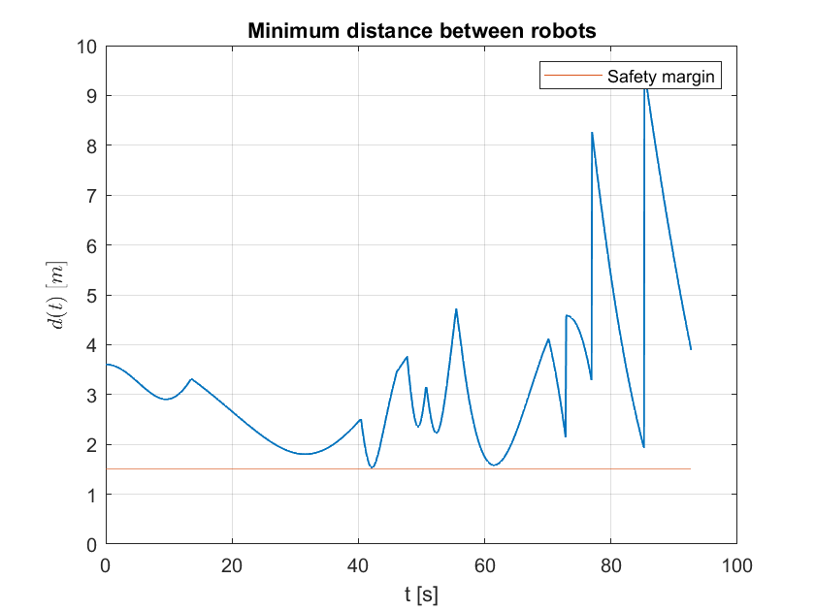
Prioritized planning
Max velocities | [1.17, 1.50, 1.44, 1.50, 0.96, 0.88, 1.50]
Finish time | 104.00 s
Total energy | 2236 J
2024 August | Slide 7

Slide 8
Prioritized planning 104.00 s / 2236 J | Genetic Algorithm
 | Single-objective |  | Multi-objective
 | Maximum velocities | Slow-down segment | Slow-down segment
Population | 1000
Crossover Factor | 60%
Mutation Rate | 70%
Generations | 200
2024 August | Slide 8

Slide 9
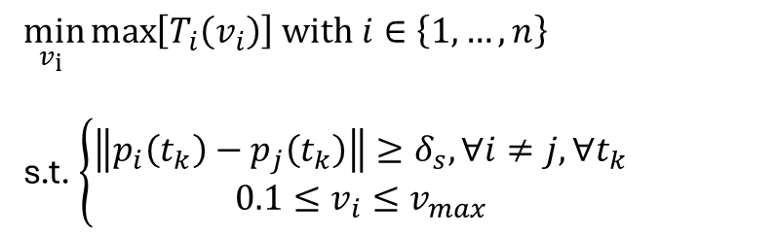
Genetic Algorithm, Maximum velocities
Problem setting
$$\min_{v_{i} }{\max\left[T_{i}\left(v_{i}\right)\right] with i∈\left\{1,…,n\right\}}$$
s.t. $\left\{\begin{aligned}\left\|p_{i}\left(t_{k}\right)−p_{j}\left(t_{k}\right)\right\|≥δ_{s}, ∀i≠j,∀t_{k} \\ 0.1≤v_{i}≤v_{max}\end{aligned}\right.$
2024 August | Slide 9

Slide 10
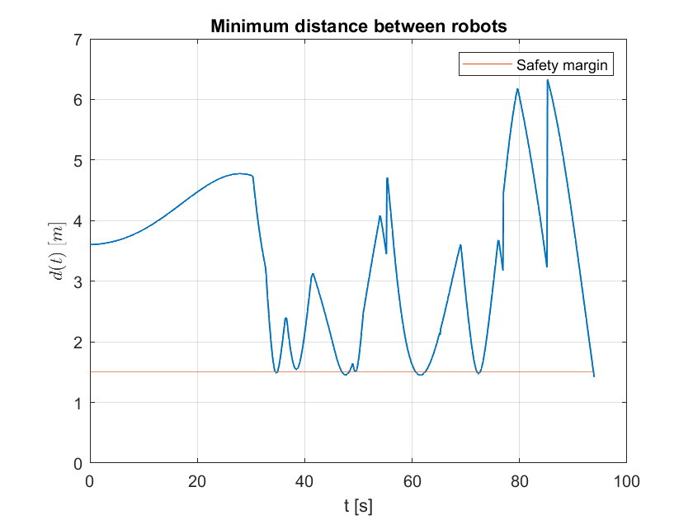
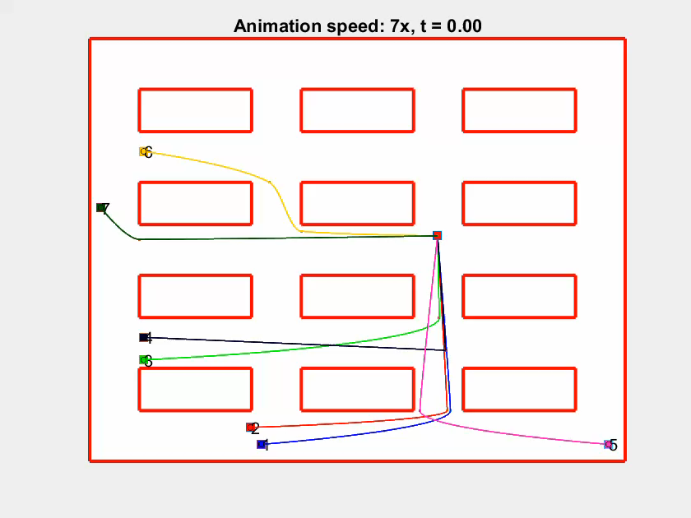
Genetic Algorithm, Maximum velocities
Max velocities | [1.1723, 1.0839, 1.0707, 1.5000, 1.4111, 1.4786, 1.3563]
Finish time | 97.80 s
Total energy | 2301 J
2024 August | Slide 10

Slide 11
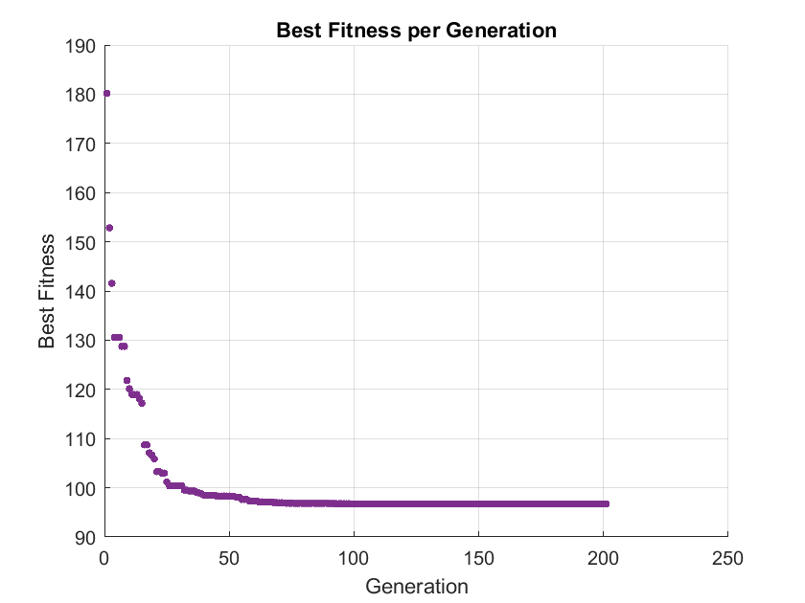
Genetic Algorithm, Maximum velocities
Best fit plot
2024 August | Slide 11

Slide 12
Prioritized planning 104.00 s / 2236 J | Genetic Algorithm
 | Single-objective |  | Multi-objective
 | Maximum velocities 97.80 s / 2301 J | Slow-down segment | Slow-down segment
Population | 1000
Crossover Factor | 60%
Mutation Rate | 70%
Generations | 400
2024 August | Slide 12

Slide 13
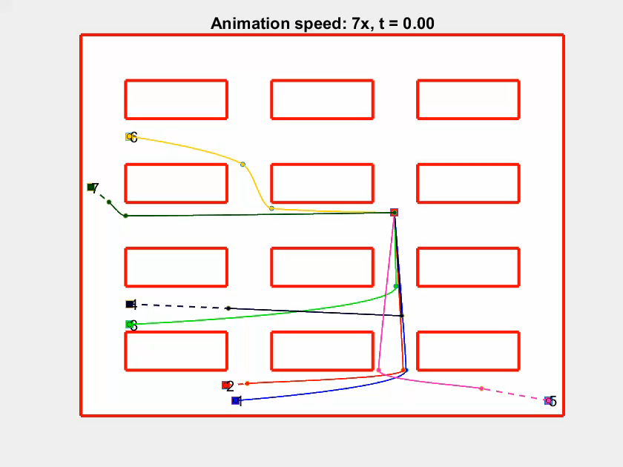
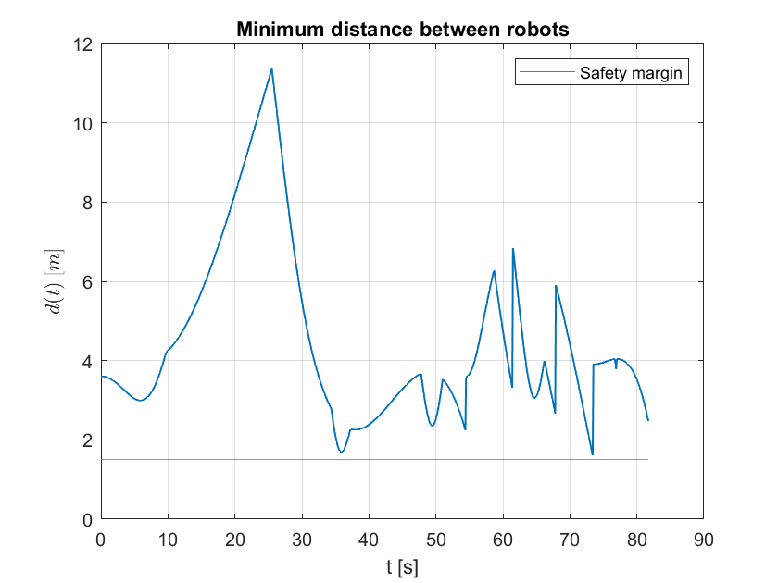
Genetic Algorithm, Slow-down segment
Finish time | 87.00 s
Total energy | 2975 J
2024 August | Slide 13

Slide 14
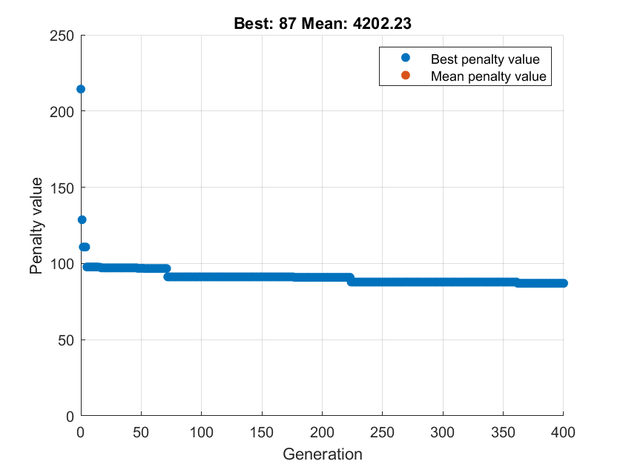
Genetic Algorithm, Slow-down segment
Best fit plot
2024 August | Slide 14

Slide 15
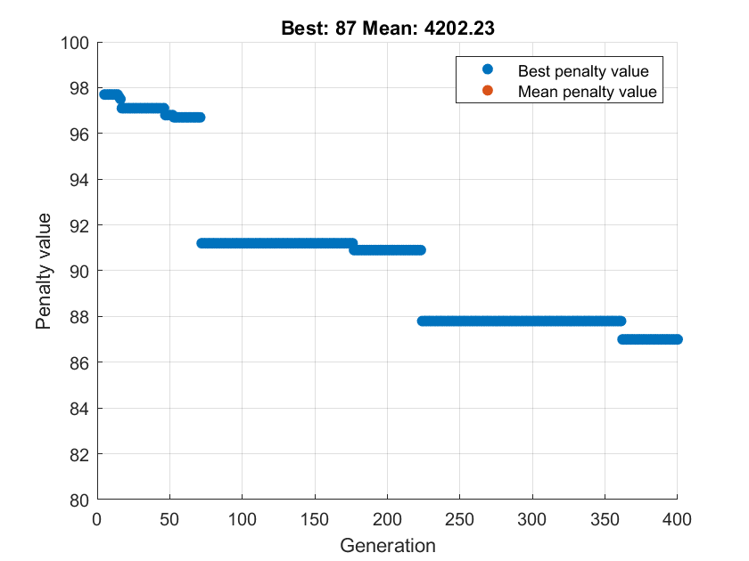
Genetic Algorithm, Slow-down segment
Best fit plot
2024 August | Slide 15

Slide 16
Prioritized planning 104.00 s / 2236 J | Genetic Algorithm
 | Single-objective |  | Multi-objective
 | Maximum velocities 97.80 s / 2301 J | Slow-down segment 87.00 s / 2975 J | Slow-down segment
Population | 1000
Crossover Factor | 60%
Mutation Rate | 70%
Generations | 200
2024 August | Slide 16

Slide 17
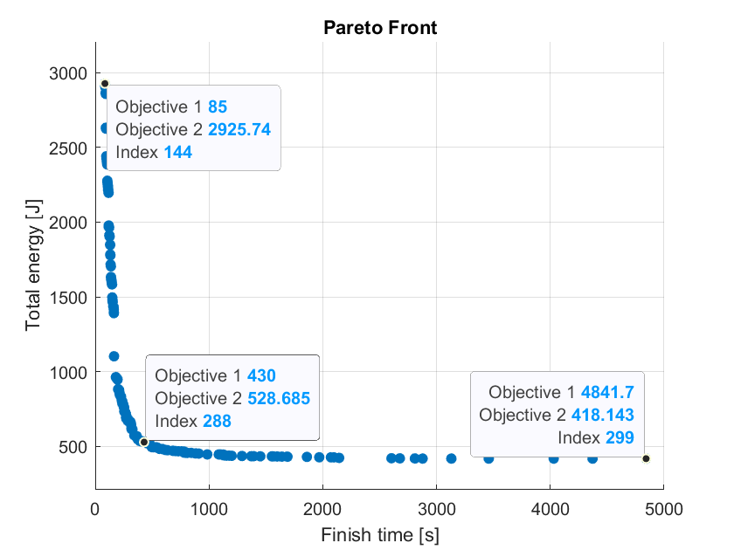
Slow-down segment approach, Multi-objective GA
Pareto front plot
2024 August | Slide 17

Slide 18
Prioritized planning 104.00 s / 2236 J | Genetic Algorithm
 | Single-objective |  | Multi-objective
 | Maximum velocities 97.80 s / 2301 J | Slow-down segment 87.00 s / 2975 J | Slow-down segment 85.00 s / 2975 J 4841 s / 428 J
Population | 1000
Crossover Factor | 60%
Mutation Rate | 70%
Generations | 200
2024 August | Slide 18

Slide 19
 | Prioritized Planning | Maximum velocities Single-objective Genetic Algortihm | Slow-down segment Single-objective Genetic Algortihm | Slow-down segment Multi-objective Genetic Algortihm
Execution time | 1.15 s | 4:00 h | 6:15 h | 3:30 h
Generations | X | 200 | 400 | 200
2024 August | Slide 19

